Slide 1


Finance Project
Presented By - Mentor – Mr. Shubham Kabre
Co-Mentor – Mr. Sivakumar
Group No - 2
1 .Mrs. Harini Vardhan OG
2. Mrs. Leena Hemant Wadibhasme
3. Mr. Bhimashankar Basawaraj Babalad

Slide 2
Domain - Banking
OVERVIEW
This is Banking dataset of loan status. Its features allows viewing loan Status from multiple IDs : Loan status, loan amount, last payment date, Loan Issue date , Home ownership ,Grade & Sub-grade, interest rate
TASK
As a data analyst our task was to generate some KPI's from the data we had been given in the form of 2 excel files and Data Size is 39k We performed an analysis on the dataset of Bank and drawn 5 KPI's to solve the business problem faced by the bank and to help them in taking better business decisions.

Slide 3






TOOLS USED
Excel
Power Bi
MySQL
Tableau

Slide 4
Key KPI’s
1. Year wise Loan Amount Stats.
2. Grade and Sub_Grade wise Revolving Balance.
3. Total Payment for Verified Status Vs Total Payment for Non Verified Status
4. State wise and Last_Credit_Pull_Date wise Loan Status.
5. Home Ownership Vs Last Payment date Stats.

Slide 5
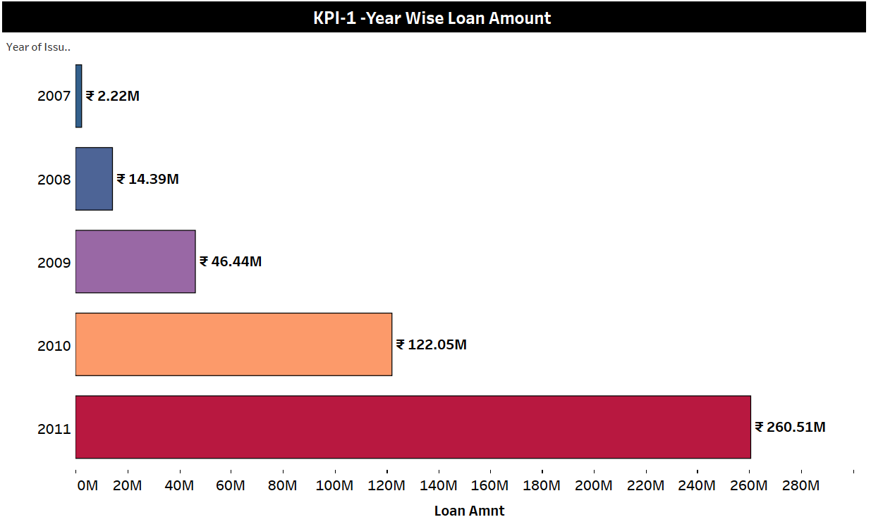
KPI-1 Total Yearly Loan Amount
According to the Loan amount, taking loan is continuously increasing by the years.
As mortgage rate is increasing year by year, so Amount of loan in 2011 is much greater than 2007.
Debit Consolidation Purpose increases likewise loan amount also increases year by year.

Slide 6
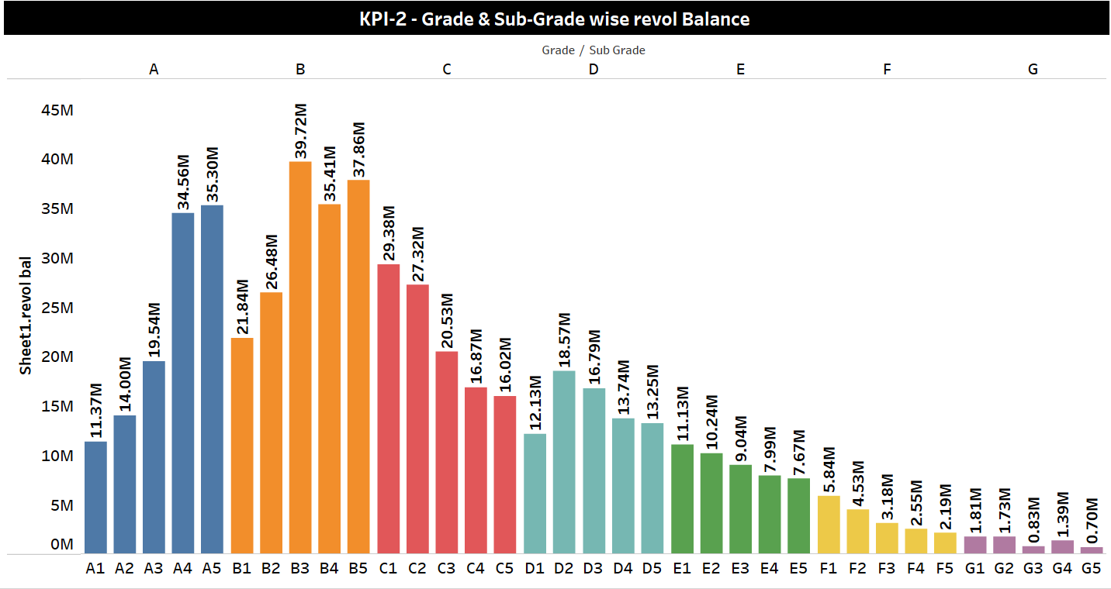
In Analysis, we observed Grade A – 114.77M [sub grade A5 highest balance & A1 is lowest balance ] Grade B – 161.31 M [sub grade B3 highest balance & B1 is lowest balance ] Grade C – 110.12 M [sub grade C1 highest balance & C5 is lowest balance ] Grade D – 74.49 M [sub grade D2 highest balance & D1 is lowest balance ] Grade E – 46 M [sub grade E1 highest balance & E5 is lowest balance ] Grade F – 18.28 M[sub grade F1 highest balance & F5 is lowest balance ] Grade G – 6.4 M [sub grade G1 highest balance & G5 is lowest balance ]. In further analysis Total payment and loan amount highest in B grade so that’s purpose revolve balance also highest in B grade and B sub-grade.
KPI-2 Grade and Sub Grade wise revolve balance

Slide 7
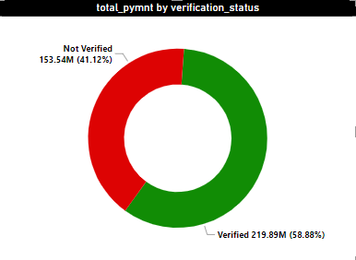
As per the report Shows Verified loan Is 58.88% (219.89 M)
Not Verified is 41.12% (153.54 M)
Total Verified Members 12.81 K
Not verified are 16.92 K
As the interest rate, loan amount is highest in verified status so Total payment also highest.
KPI-3 Total Payments By Verification Status

Slide 8
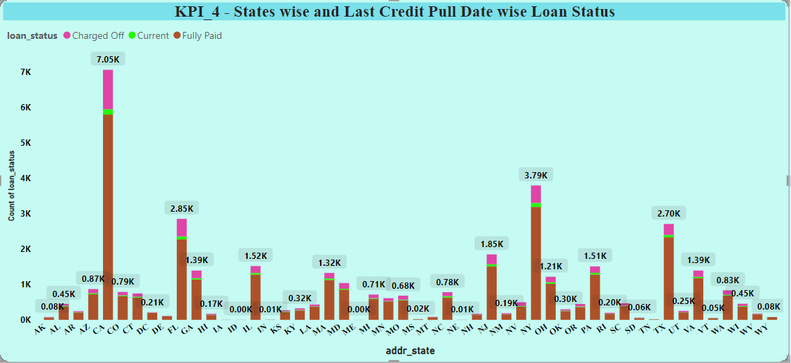
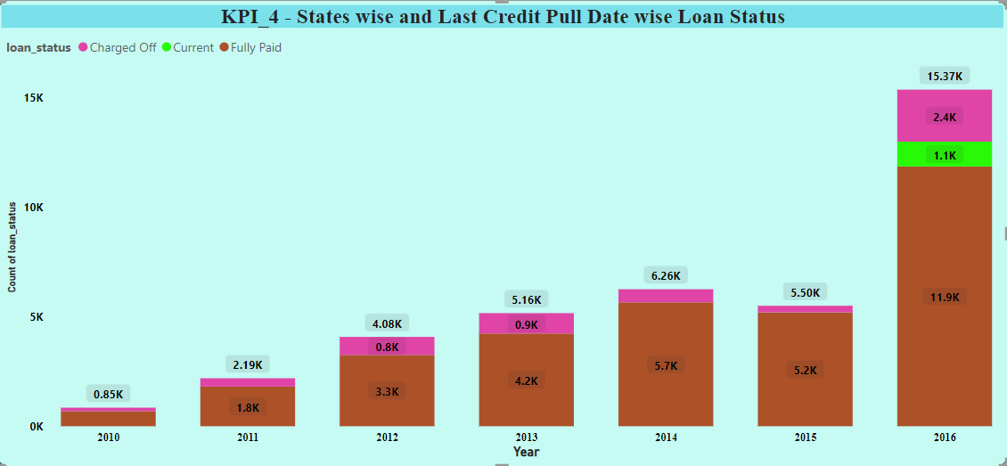
KPI-4 State And Last Credit Pull_D wise loan status
CA had the highest Count of of loan_Status because No of members have more, Total count of Loan status has 39717.
﻿In 2016 members Annual income has highest compared to other credi_pull_d year.
Rate of Interest had lowest in 2016.
by reducing the rate of interest bank can offer loans to their customer’s and earn more profit, in state where credit ratio is low.

Slide 9
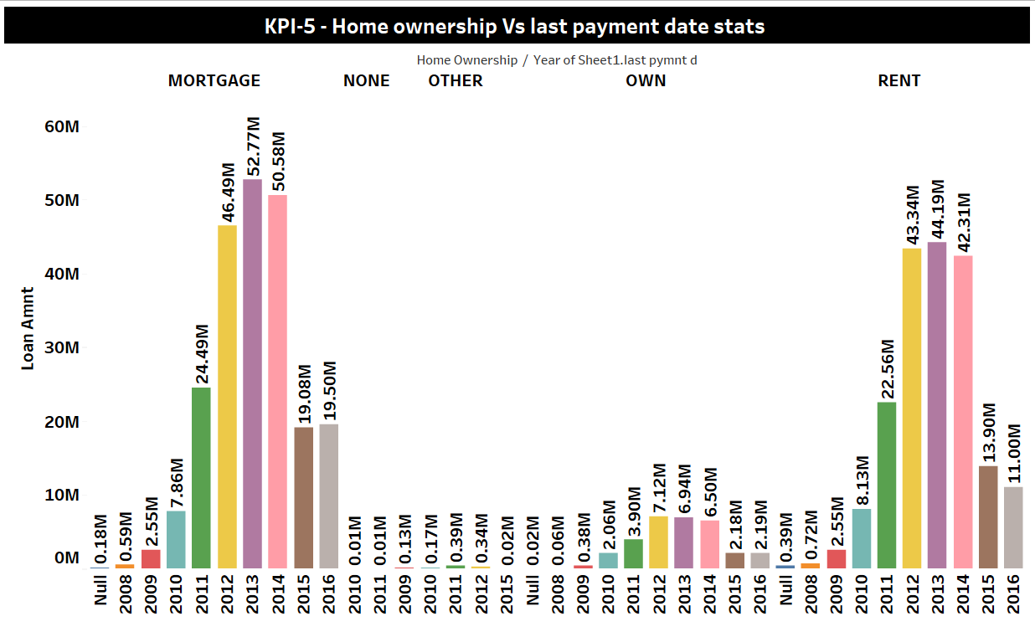
KPI-5 Home Ownership VS Last Payment Date Stats
In the year 2013, the Loan amount of Mortgage who has done payment on last payment date is maximum (i.e: 52.7M).
Debit Consolidation rate in 2013:
Mortgage- 26M
Own-3.48M
Rent-25.8M
Overall, Loan Amount by the Home ownership:
Mortgage - 224.09M
Others – 1.04
Own – 31.37M
Rent – 189.08M

Slide 10
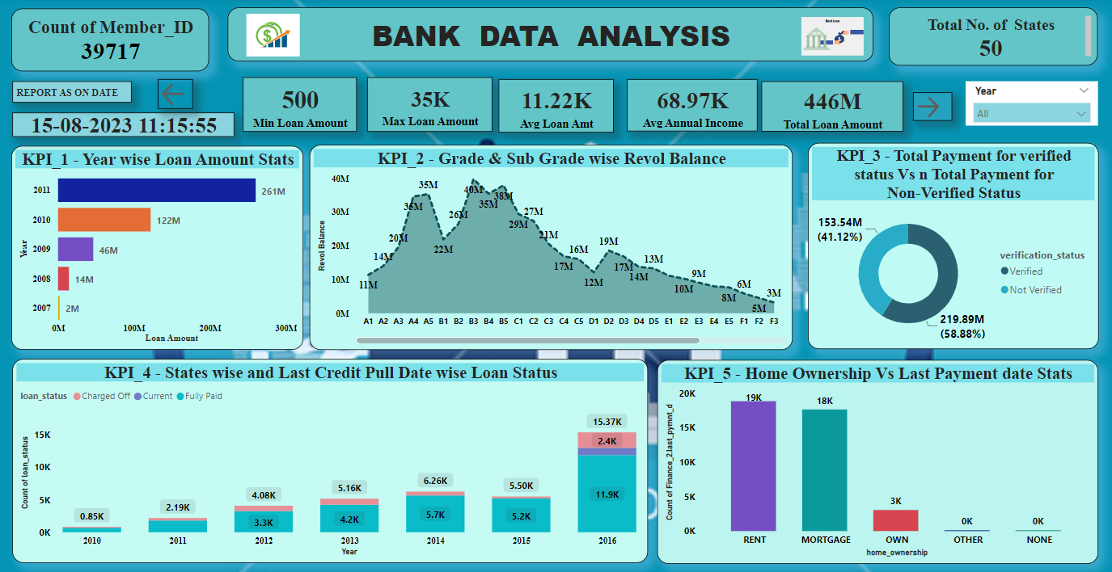
DASHBOARD

Slide 11
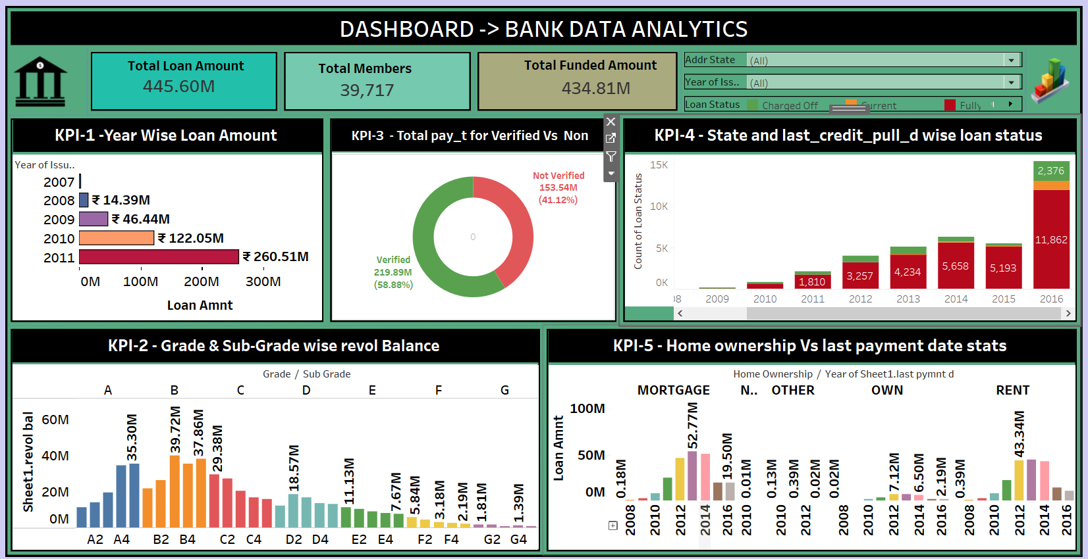
DASHBOARD

Slide 12
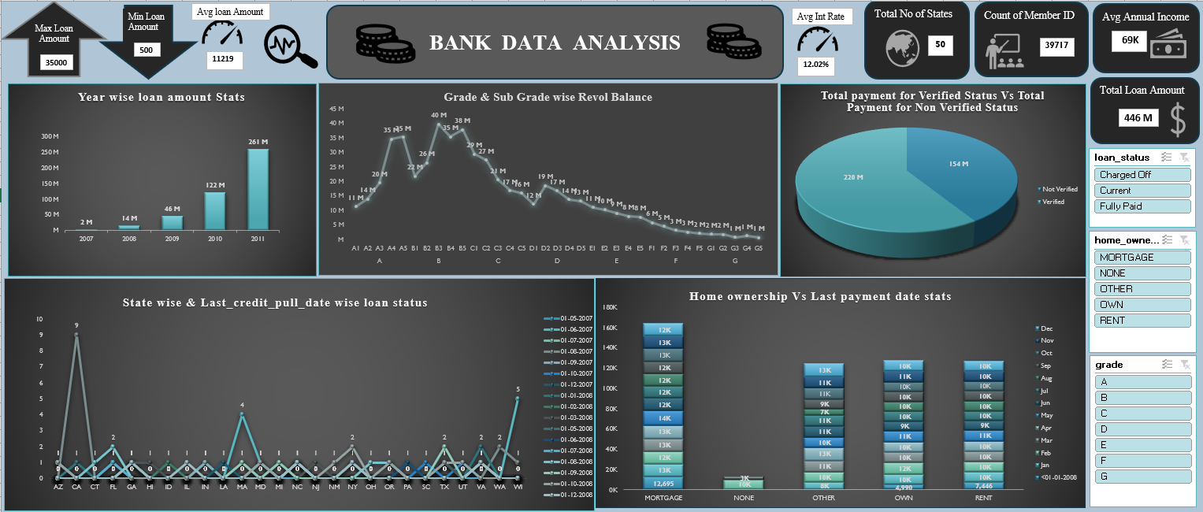
DASHBOARD

Slide 13
Conclusion
We can reduce the rate of interest in some of the states where number of customers is very low so that the number of customers can increase.
Once number of customers gets increased at a certain limit where bank will not get in loss. We can slightly increase the rate of interest so that bank will generate a good revenue from the interest.
*grade` A´ to grade `B´ it move upwards after grade B it moves diminishing till Grade `G´.
The bank should increase the count of verified members as now not verified customers are maximum as compared to verified customers
that is verified members = 12.81 K & Not verified = 16.92 K
If the bank increase the rate of interest for not verified members, then the not verified members automatically shifted to verified members
The one who took loan for rent and mortgage had paid the loan payment on the last payment date.

Slide 14

4

